Slide 1
Data Warehousing

Slide 2
What exactly is a data warehouse?
A data warehouse refers to a database that is maintained separately from an organization’s operational databases. Stores the information on which an enterprise needs to make strategic decisions.
They support information processing by providing a solid platform of consolidated historical data for analysis.
According to William H. Inmon, a leading architect in the construction of data warehouse systems,
“A data warehouse is a subject-oriented, integrated, time-variant, and nonvolatile collection of data in support of management’s decision-making process”

Slide 3
Subject-oriented: A data warehouse is organized around major subjects, such as customer, supplier, product, and sales. Rather than concentrating on the day-to-day operations and transaction processing of an organization, a data warehouse focuses on the modeling and analysis of data for decision makers.
Integrated: A data warehouse is usually constructed by integrating multiple heterogeneous sources, such as relational databases, flat files, and on-line transaction records.
Time-variant: Data are stored to provide information from a historical perspective
(e.g., the past 5–10 years). Every key structure in the data warehouse contains, either
implicitly or explicitly, an element of time.
Nonvolatile: Meaning that previous digital information does not get erased when new data is loaded into the system. Due to this separation, a data warehouse does not require transaction processing, recovery, and concurrency control mechanisms.

Slide 4
“How are organizations using the information from data warehouses?”
Many organizations use this information to support business decision-making activities, including
(1) increasing customer focus, which includes the analysis of customer buying patterns (such as buying preference, buying time, budget cycles, and appetites for spending);
(2) repositioning products and managing product portfolios by comparing the
performance of sales by quarter, by year, and by geographic regions in order to fine-tune production strategies;
(3) analyzing operations and looking for sources of profit;
(4) managing the customer relationships.

Slide 5
The major task of online operational database systems is to perform online transaction and query processing. These systems are called online transaction processing (OLTP) systems
They cover most of the day-to-day operations of an organization, such as purchasing, inventory, manufacturing, banking, payroll, registration, and accounting.
Data warehouse systems, on the other hand, serve users or knowledge workers in the role of data analysis and decision making.
These systems are known as online analytical processing (OLAP) systems.
OLAP systems are optimized for complex, read-heavy queries(focus predominantly on retrieving (reading) data rather than modifying (inserting, updating, or deleting)), aggregations, and analysis across dimensions.

Slide 6
Data warehouses and OLAP tools are based on a multidimensional data model.
This model views data in the form of a data cube.
What is a data cube?” A data cube allows data to be modeled and viewed in multiple dimensions. It is defined by dimensions and facts.
dimensions are the perspectives or entities with respect to which an organization wants to keep records
Example: AllElectronics may create a sales data warehouse in order to keep records of the store’s sales with respect to the dimensions time, item, branch, and location. These dimensions allow the store to keep track of things like monthly sales of items and the branches and locations.
Each dimension may have a table associated with it, called a dimension table, which further describes the dimension.

Slide 7
A multidimensional data model is typically organized around a central theme, like
sales, for instance. This theme is represented by a fact table.
Facts are numerical measures.
Think of themes as the quantities by which we want to analyze relationships between dimensions.
The fact table contains the names of the facts, or measures, as well as keys to each of the related dimension tables.

Slide 8
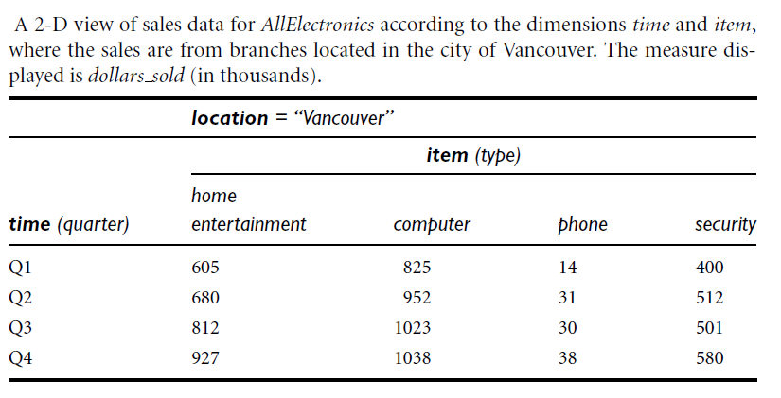

Slide 9
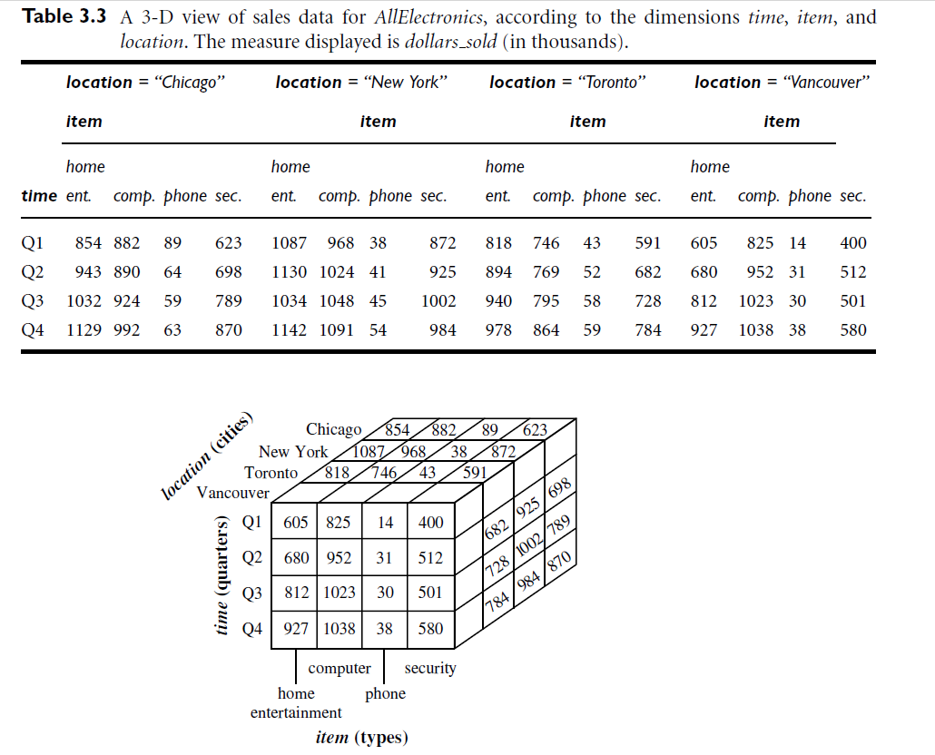
Other facts could be
units sold (number of units sold),
and amount budgeted

Slide 10
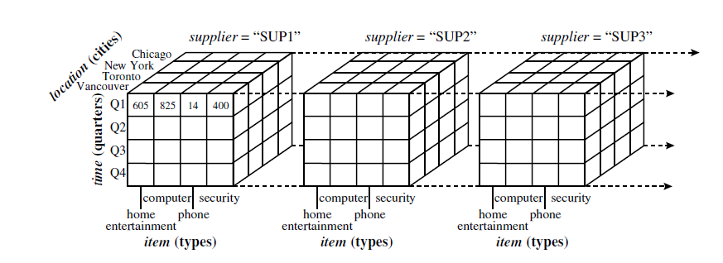
Suppose that we would now like to view our sales data with an additional fourth
dimension, such as supplier. Viewing things in 4-D becomes tricky. However, we can think of a 4-D cube as being a series of 3-D cubes, as shown in Figure 3.2
If we continue in this way, we may display any n-D data as a series of (n-1)-D “cubes.

Slide 11
Stars, Snowflakes, and Fact Constellations: Schemas for Multidimensional Databases
The entity-relationship data model is commonly used in the design of relational
databases, where a database schema consists of a set of entities and the relationships
between them. Such a data model is appropriate for on-line transaction processing.
A data warehouse, however, requires a concise, subject-oriented schema that facilitates on-line data analysis.
The most popular data model for a data warehouse is a multidimensional model.
Such a model can exist in the form of a star schema, a snowflake schema, galaxy schema.

Slide 12
Star schema: The most common modeling paradigm is the star schema, in which the
data warehouse contains
(1) a large central table (fact table) containing the bulk of
the data, with no redundancy, and
(2) a set of smaller attendant tables (dimension tables), one for each dimension. The schema graph resembles a starburst, with the dimension tables displayed in a radial pattern around the central fact table
Snowflake schema: The snowflake schema is a variant of the star schema model, where some dimension tables are normalized, thereby further splitting the data into additional tables. The resulting schema graph forms a shape similar to a snowflake.

Slide 13
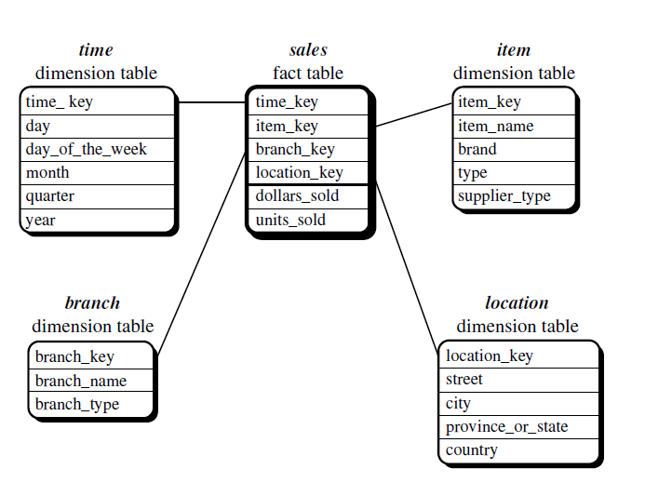
Star schema:

Slide 14
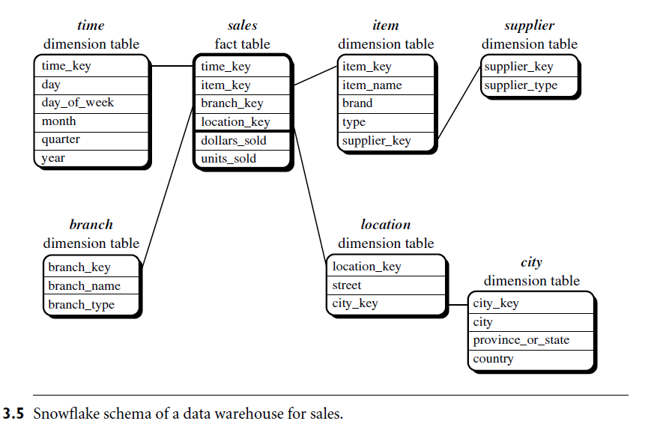
Snowflake schema:

Slide 15
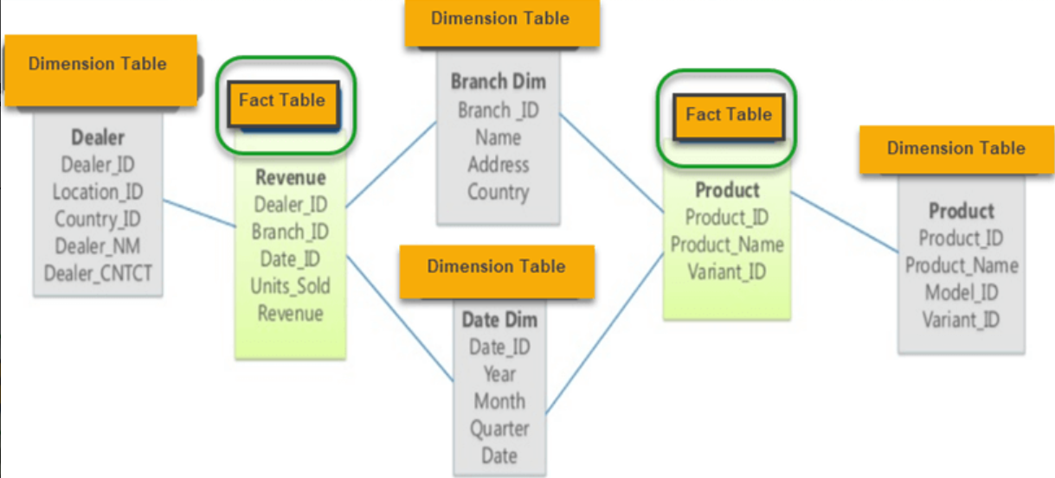

Slide 16
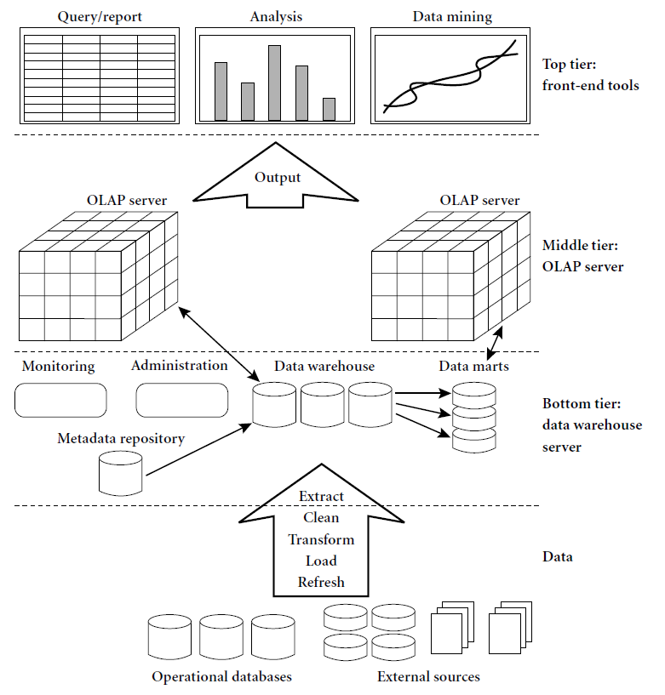
Data Warehouse
Architecture
The implementation of a Data Warehouse involves several steps:

Slide 17
An OLAP (Online Analytical Processing) server is the heart of analytical processing in a data warehouse system. It allows users to analyze large volumes of multidimensional data efficiently and interactively
it organizes data into OLAP cubes, which allow analysis across multiple dimensions (like time, product, location).
Executes complex queries that involve aggregation, grouping, filtering, and comparisons.
Example queries:
“Total sales per region for Q1 2025”
“Compare sales of Product A vs Product B over the past year”
Provides data to reporting, dashboard, and data mining tools.

Slide 18
A Data Warehouse consists of several components that work together to store, manage, and retrieve large volumes of data. The key components are:
Data Sources: These include operational databases, transactional systems, and external data sources from which data is extracted.
ETL Process (Extract, Transform, Load): This process extracts data from source systems, transforms it into a suitable format, and loads it into the data warehouse.
Data Storage: The central repository where processed data is stored. It can be a relational database or a multidimensional OLAP model.
Metadata Repository: Stores information about the data warehouse such as schema definitions, transformation rules etc.
OLAP Servers: The multidimensional data is stored in OLAP cubes on OLAP servers within a data warehousing environment.
Data Marts: Smaller, department-specific data warehouses used for specialized analysis.
Reporting & Visualization Tools: Tools like Tableau, Power BI that provide insights from the warehouse data.

Slide 19
The implementation of a Data Warehouse involves several steps:
Business Requirements Analysis: Identify business goals and key metrics.
Data Modeling: Design the warehouse schema (Star, Snowflake, or Galaxy).
ETL Development: Extract data from source systems, clean it, and load it into the warehouse.
Data Storage Setup: Choose a suitable database (e.g., Oracle, SQL Server, Amazon Redshift).
OLAP & Query Optimization: Implement indexing and materialized views for faster queries.
BI & Reporting Tools Integration: Develop dashboards and reports for business users.
Testing & Deployment: Validate data accuracy and optimize performance before going live.

